Slide 1
Project 1: Guide
EE232
3/30/2015

Slide 2
Connection Options
Class Account (a bit slow):
hpse-12.eecs, hpse-13.eecs, hpse-14.eecs, hpse-15.eecs
Device group members have access to their own servers. Ask a member of your group.
Install on your workstation at your desk (must have linux installed).

Slide 3
EECS Instructional Connection
Connection via X11 (graphical SSH)
Install the following software on your computer first:
(Windows and Mac): X2GO http://wiki.x2go.org/
Alternative: Windows: MobaXterm http://mobaxterm.mobatek.net/download.html
Alternative: Mac: Xquartz http://xquartz.macosforge.org/landing/

Slide 4
Some Notes about connecting
Each time swb is run, you must select the folder where your sentaurus projects reside (STDB). This can be your home directory or a folder your create.
Sentaurus will only run while you stay connected. If you lose your connects the program (and you simulations) will stop.
If your connection is spotty, consider remote desktop to a windows server on campus and doing your remote X11 session from that computer.
For more details, see inst website (http://inst.eecs.berkeley.edu/cgi-bin/pub.cgi?file=synopsys.help)

Slide 5
Getting Started
Copy ‘EE232_Proj1’ to your directory
Import project in sentaurus
Save and pre-process
Run your simulation
View your device structure with svisual
View your simulation results with svisual

Slide 6
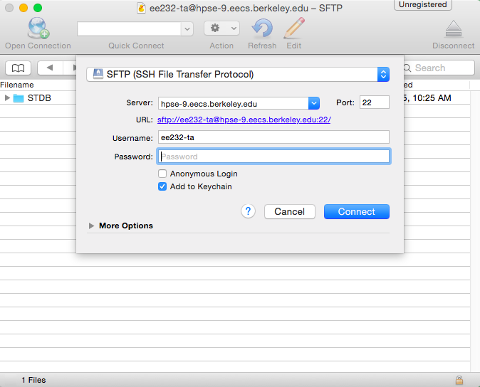
Copy Proj to your STDB directory
If you don’t have an STDB directory, then create one.
Using SFTP copy the example (EE232_Proj1.gzp) to your project directory.
Mac: cyberduck (https://cyberduck.io/?l=en)
Window: WinSCP (http://winscp.net/eng/index.php)
Connect (e.g. hpse-12.eecs.berkeley.edu) for SFTP

Slide 7
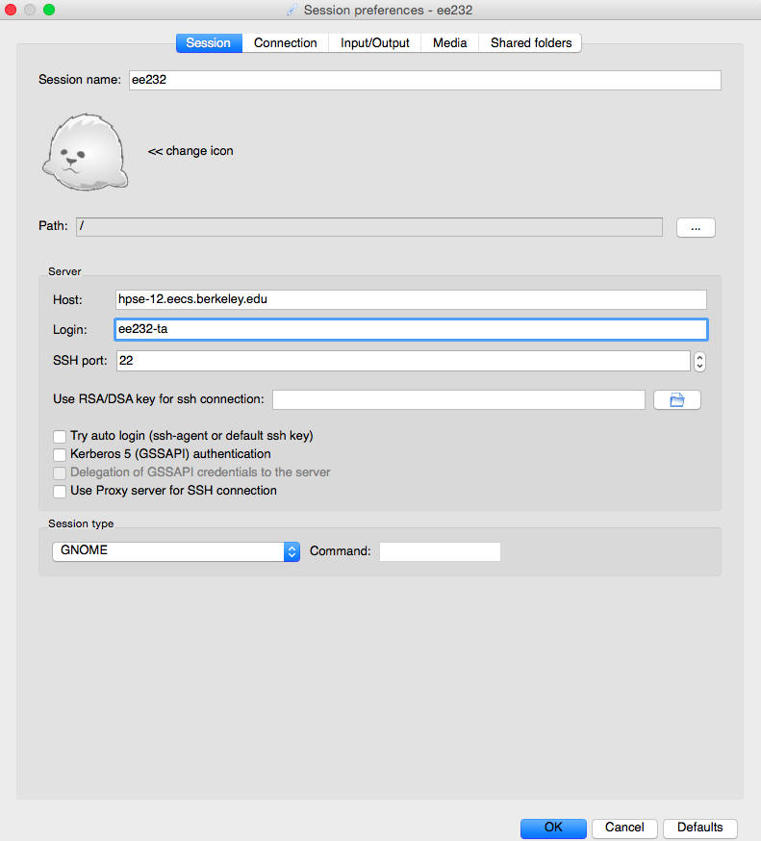
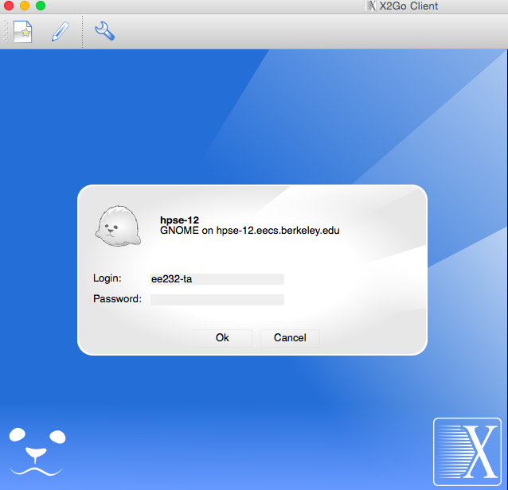
Connect to server (X2GO)

Slide 8
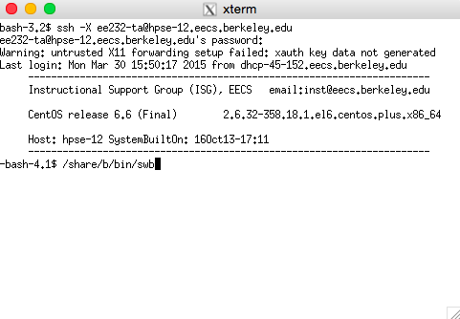
Connect to server (X11 Forwarding)
ssh -X username@hpse-12.eecs.berkeley.edu
Launch Sentaurus workbench:
Type ‘/share/b/bin/swb’

Slide 9
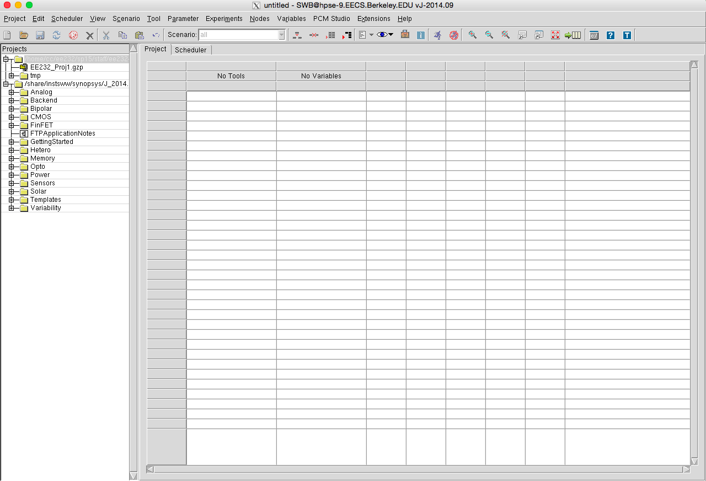
Open Sentaurus
Your project directory
Example project
Other Examples:
Can copy these to your project directory.

Slide 10
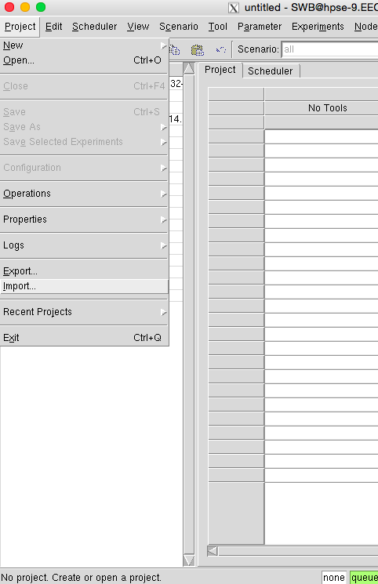
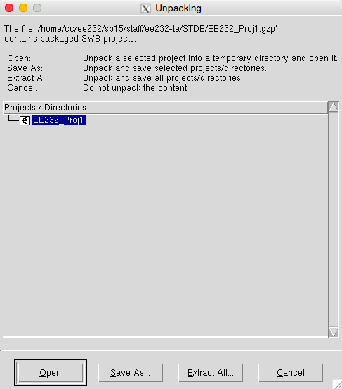
Import zipped example
Go to ‘Project -> Import…’
Select the EEL-1D project and click ‘Save As…’ or ‘Extract All..’ to save to your project directory.

Slide 11
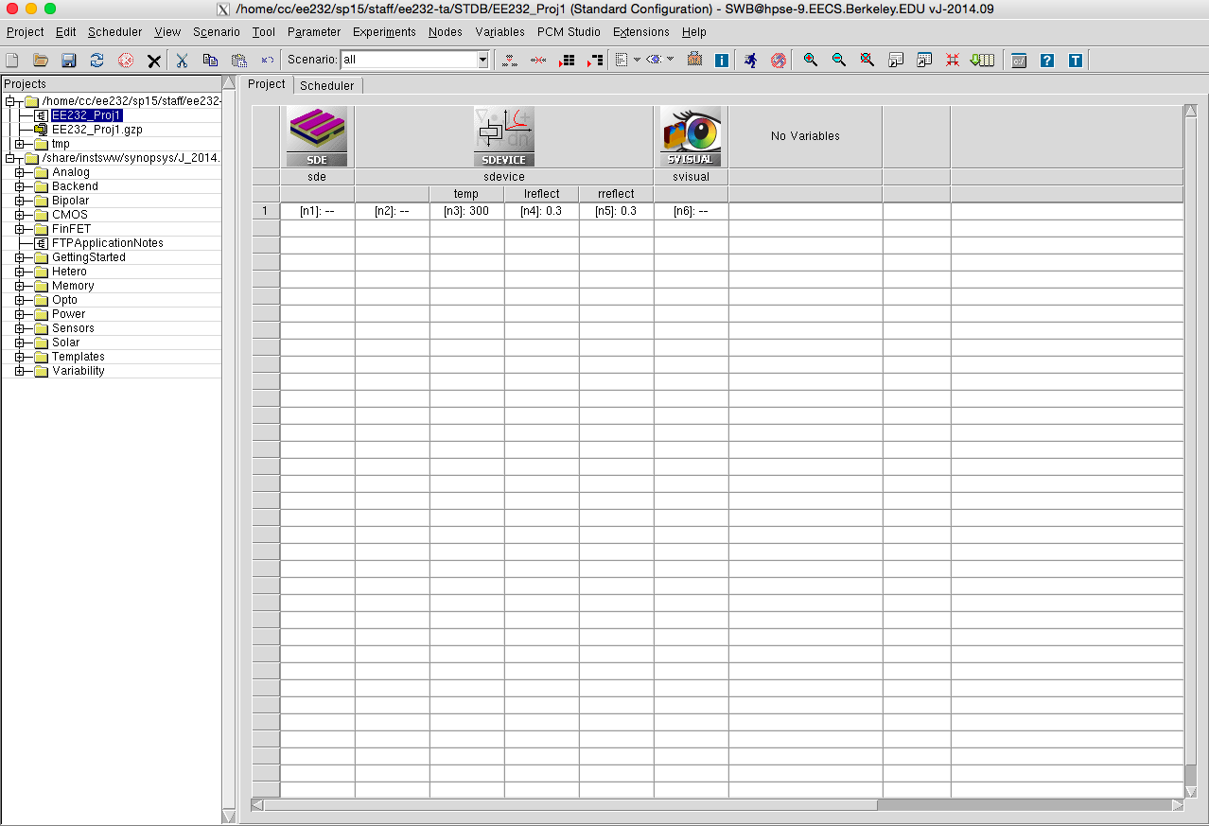
Layout of SWB
Simulation tools
Parameter for simulation
Individual Simulation Node

Slide 12
Layout of SWB
Data analysis and visualization with svisual
Edit Devices with SDE
Electrical and Optical Simulations with SDEVICE

Slide 13
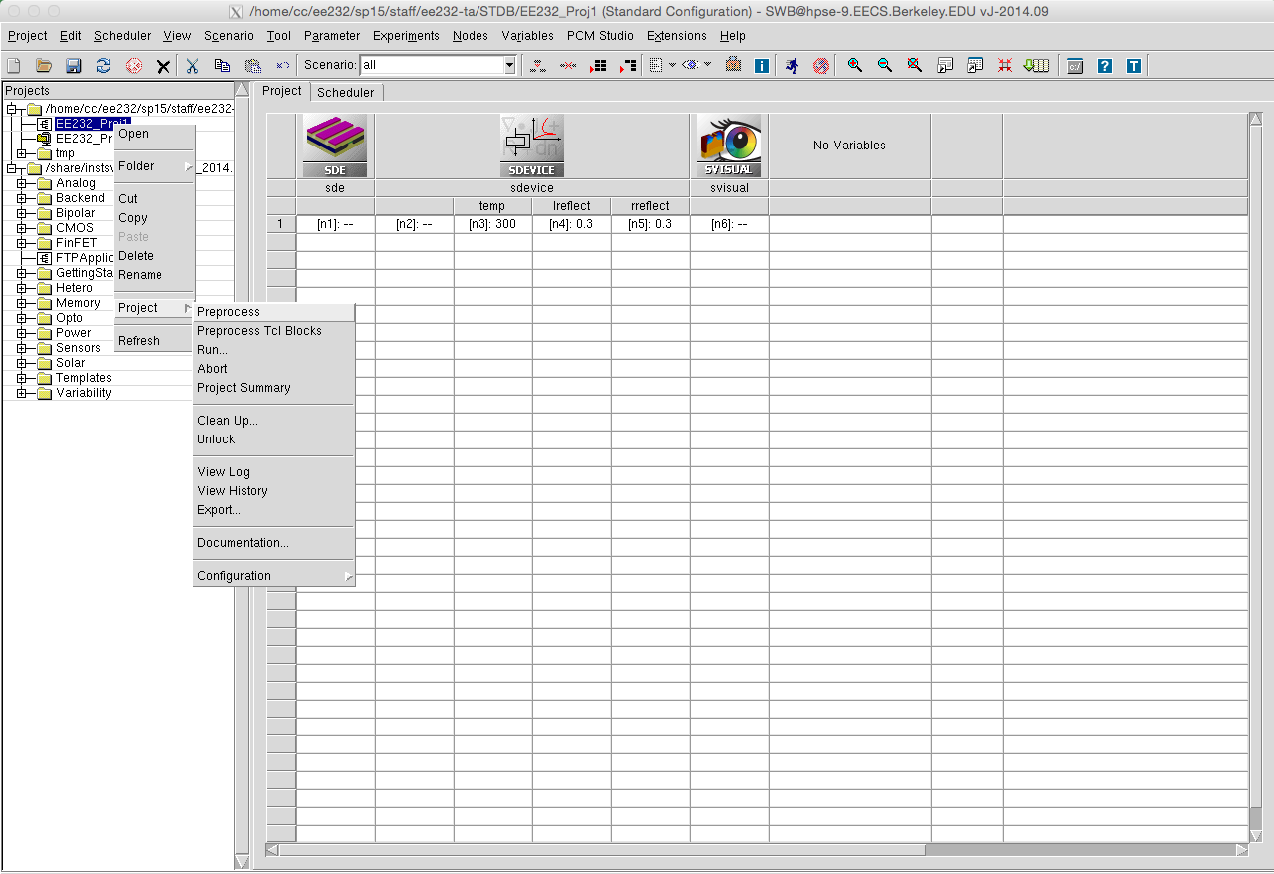
Save and Preprocess Before Running
Right click on project, ‘Project->Preprocess’

Slide 14
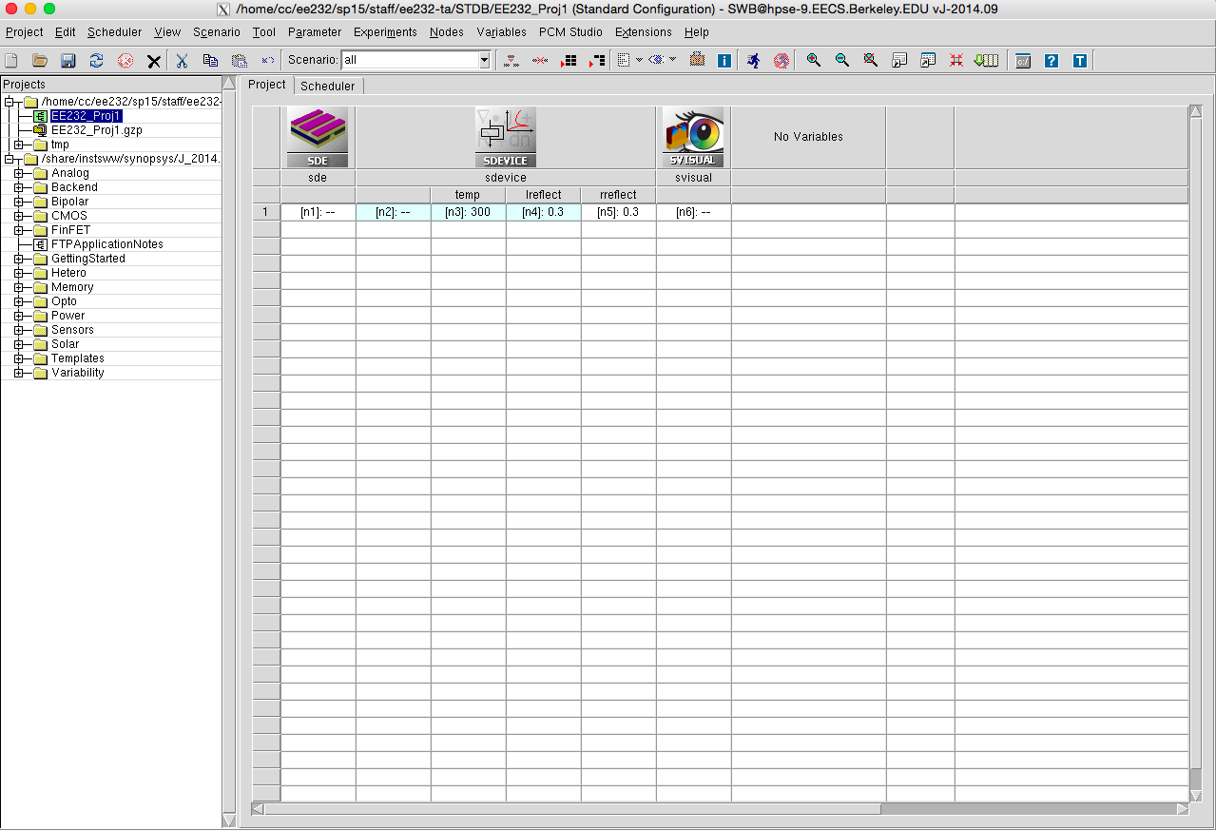
Run Simulation

Slide 15
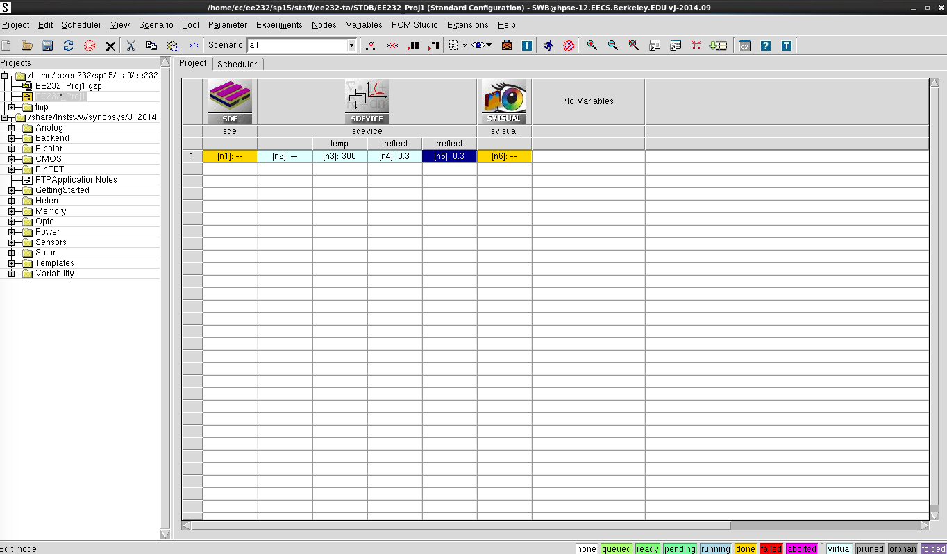
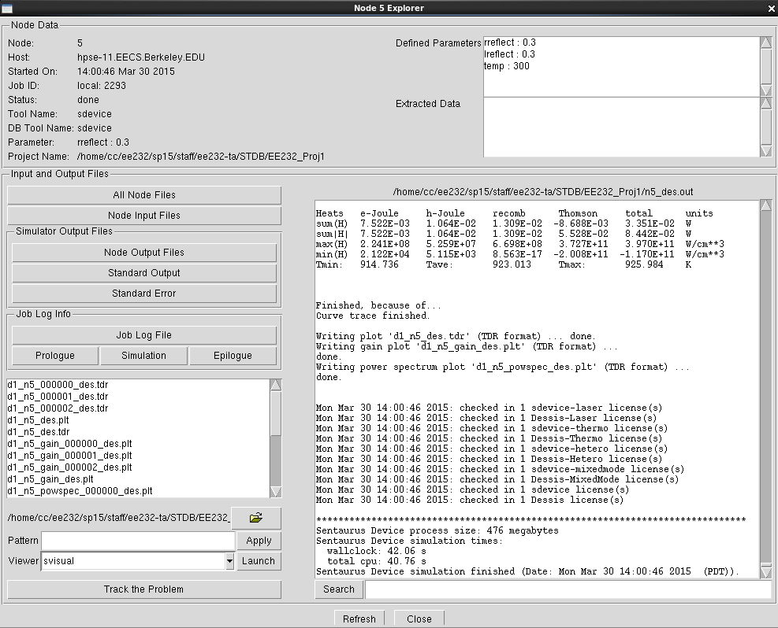
View sdevice output
Double click on the device simulation node to view the text output.

Slide 16
View Structure with Svisual
Select node and click the ‘Quick Visualize’ button

Slide 17
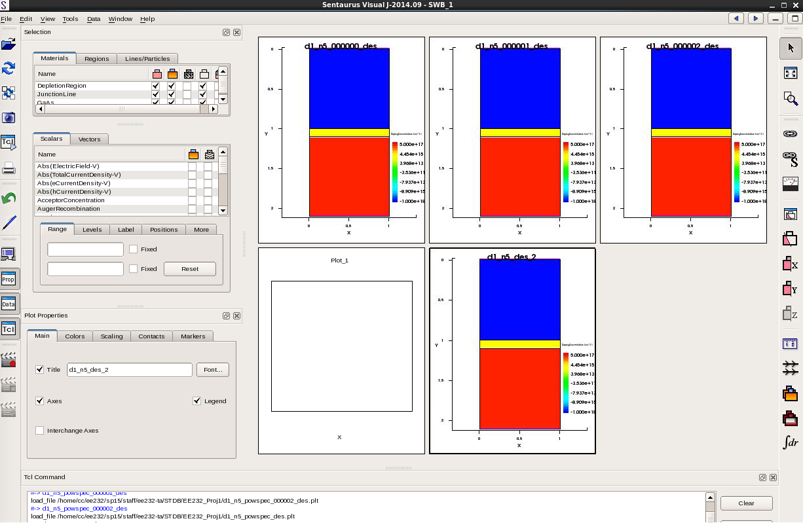
Structure in svisual
Can see many aspects of structure including dimensions, doping level, contacts, etc.
Visualizing sdevice node can also show carrier concentration, electric field, material gain, etc. at given bias points.

Slide 18
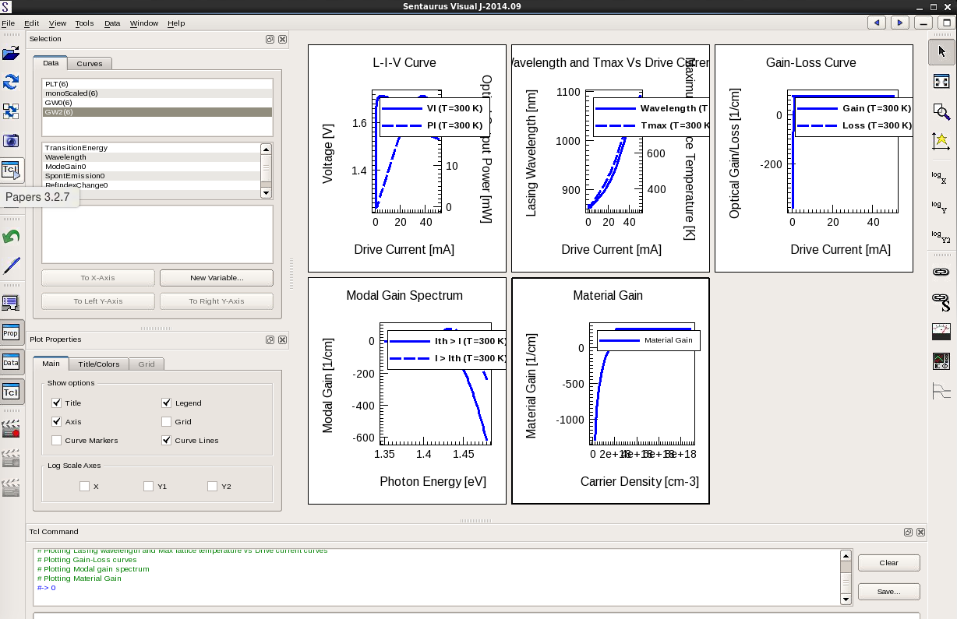
Data Analysis with svisual
Click on svisual node and click run. Svisual script will analyze results and create graphs.
You can edit the svisual command file to view script commands or add new analyses.

Slide 19
Enlarge specific graph
Click to enlarge a graph

Slide 20
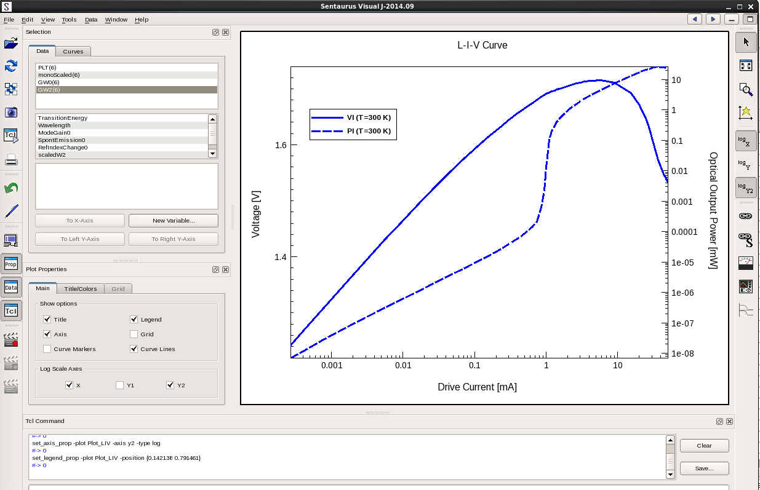
Change Axes

Slide 21
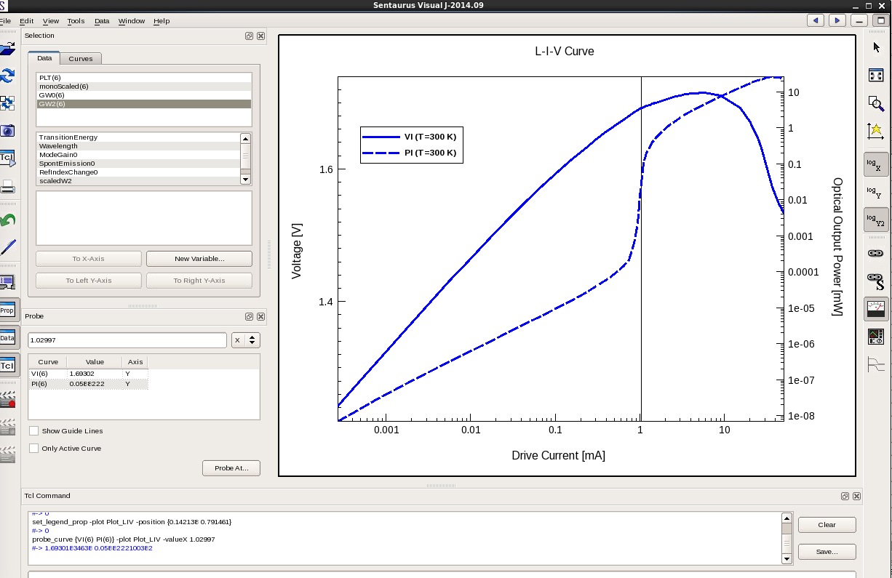
Select Values from graph
Use the probe tool to click data points on graph
See data point values here

Slide 22
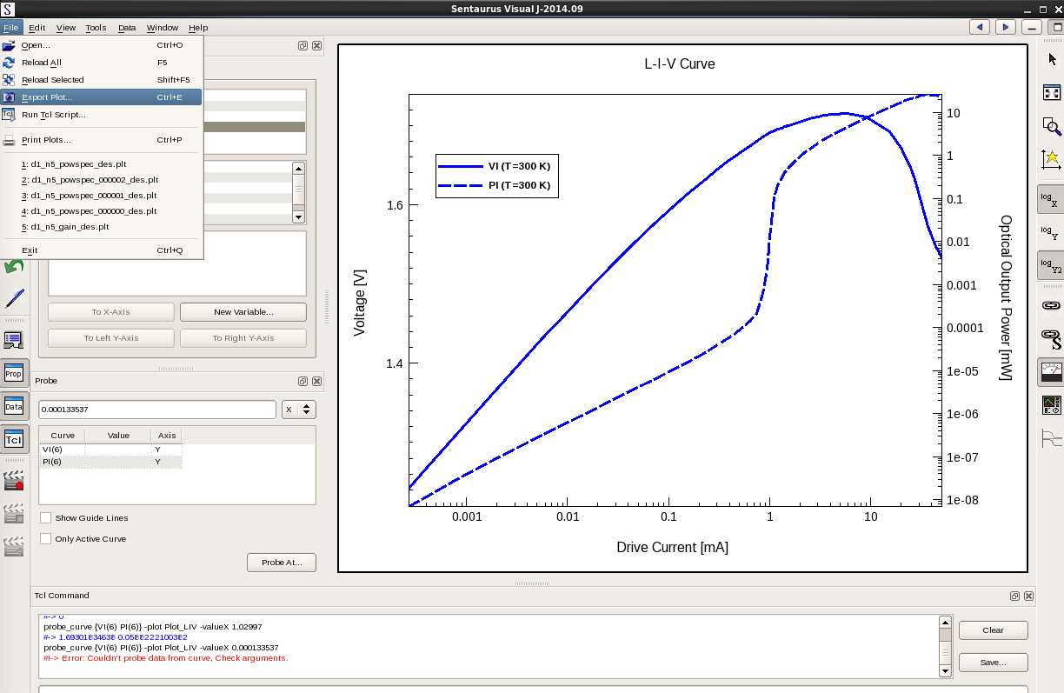
Export Graphs/Data
File->Export Plot...
Will export your selected plot as a .png file.

Slide 23
Sentaurus Manuals
Manuals for the basic sentaurus tools are posted on piazza for the class.
They can be found on the server here:
/share/instsww/synopsys/J_2014.09/tcad/J-2014.09/manuals/PDFManual/data
Don’t post or share the manuals publicly as part of the license agreement Berkeley has with synopsis.

